Slide 1
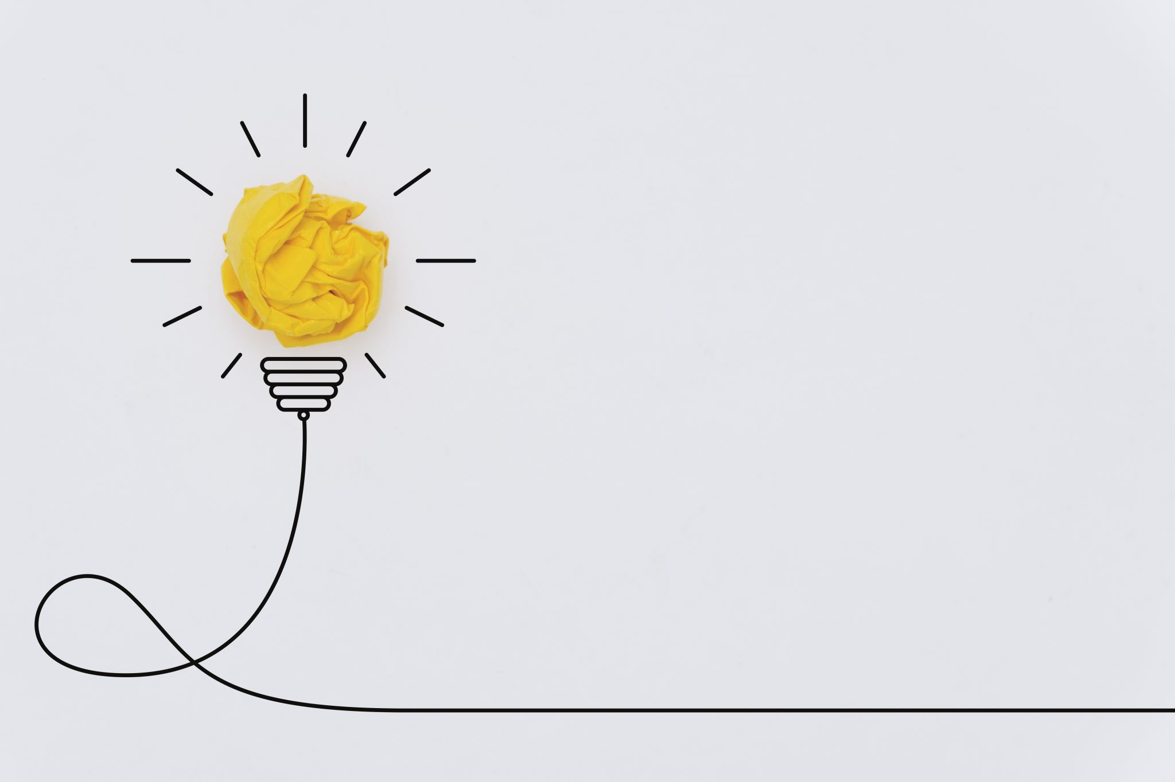

ECS 511: SUSTAINABLE MANUFACTURING
3-WAY DIMMABLE LED DESK LAMP
Submitted by: Rishi Siddanth Yaga - 627161225 - riyaga@syr.edu

Slide 2
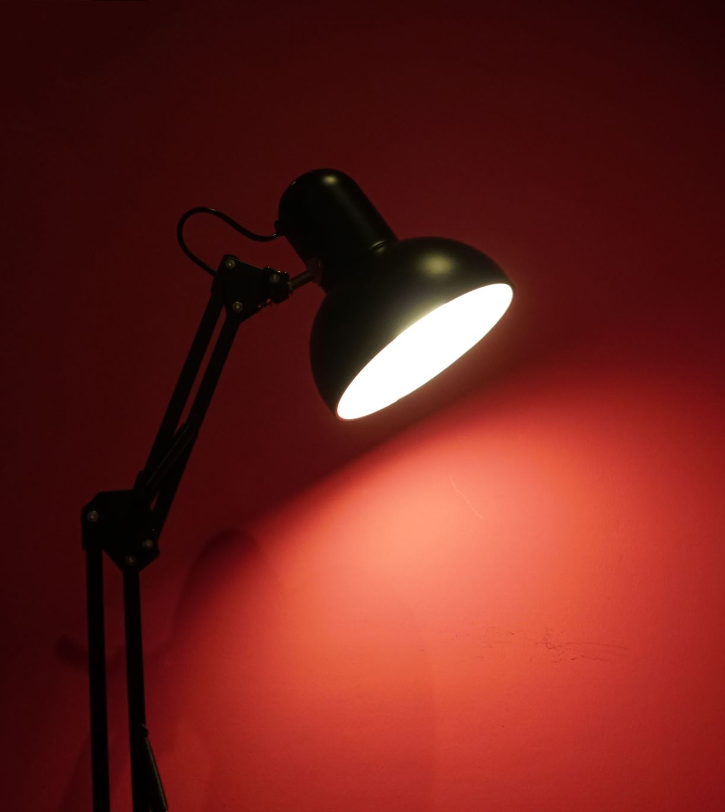
INTRODUCTION LED DESK LAMP
The product analyzed is a LED desk lamp by ‘Mainstays’. The Mainstays table lamp uses less energy and is cooler to the touch than CFL or incandescent bulbs. With 3.5-watt high-power LEDs boasting 240 lumens and no need to replace bulbs, it is a definite energy saver. The Mainstays LED Desk Lamp contains no mercury and have 3 different light modes and 3 Brightness Level. The following are the features of the table lamp:
Bulb: 3.5-watt LED
Movement Type: Electric
Power Source: Power Cable & USB Charging
Materials: Plastic & Aluminum
Dimensions: 4.70 x 9.30 x 14.30 Inches
Key Features: 3-way Dimmable Lights, USB Charging

Slide 3
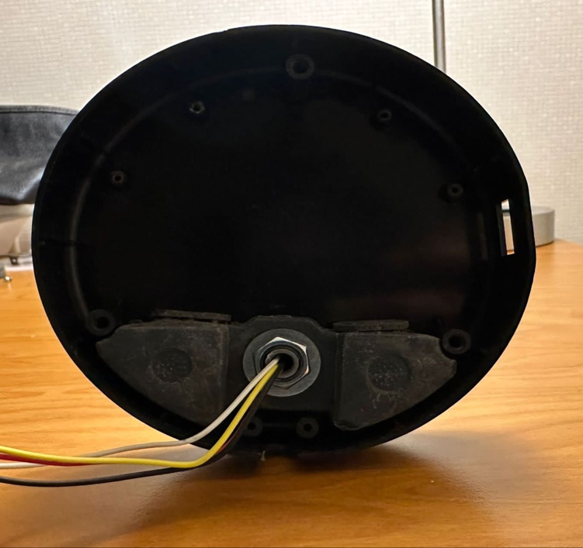
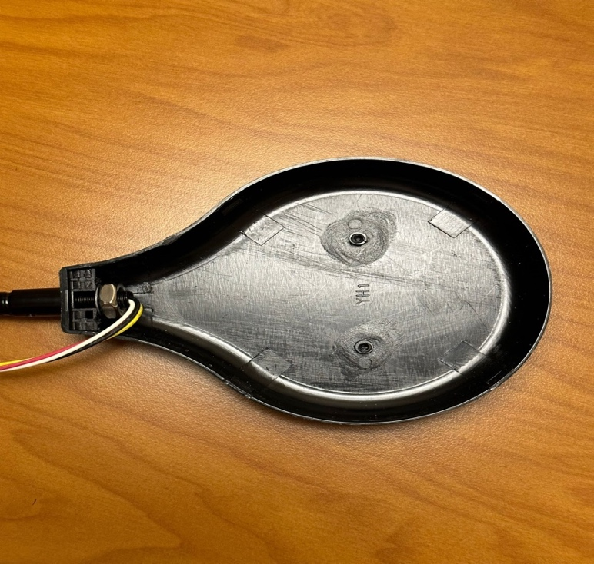
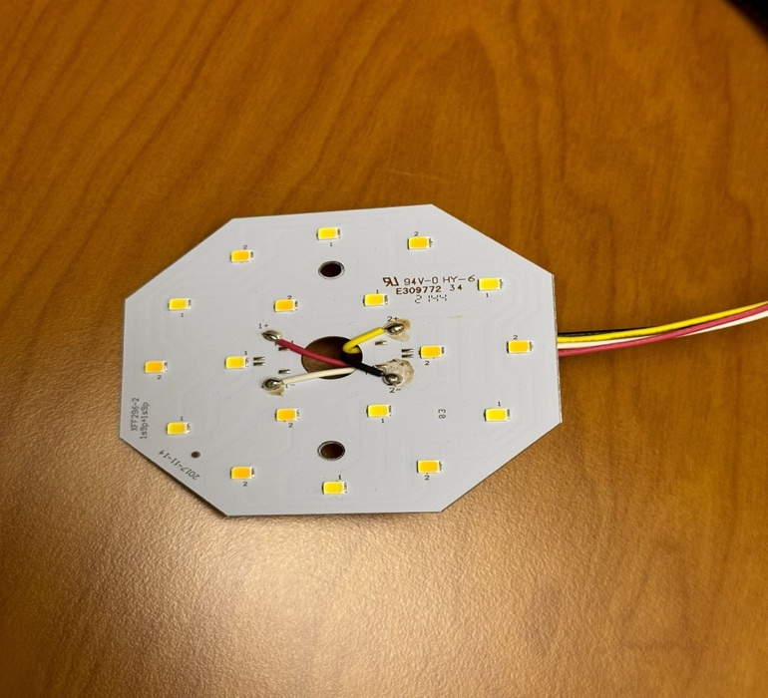
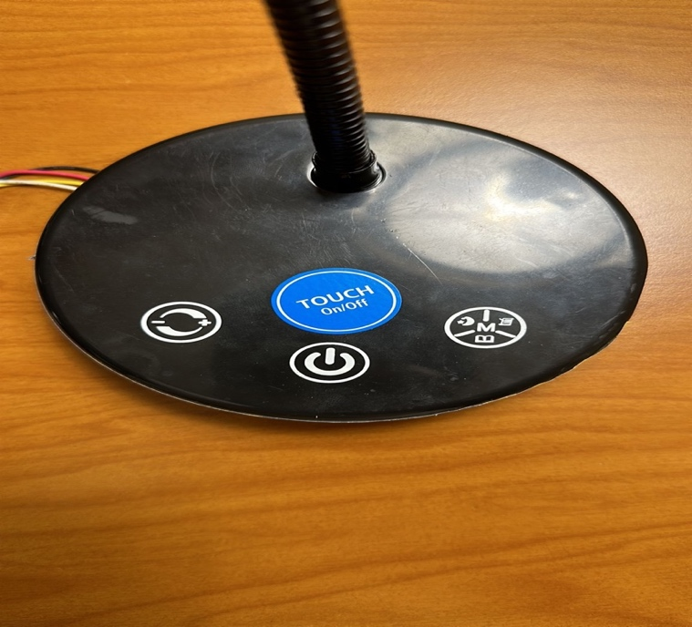
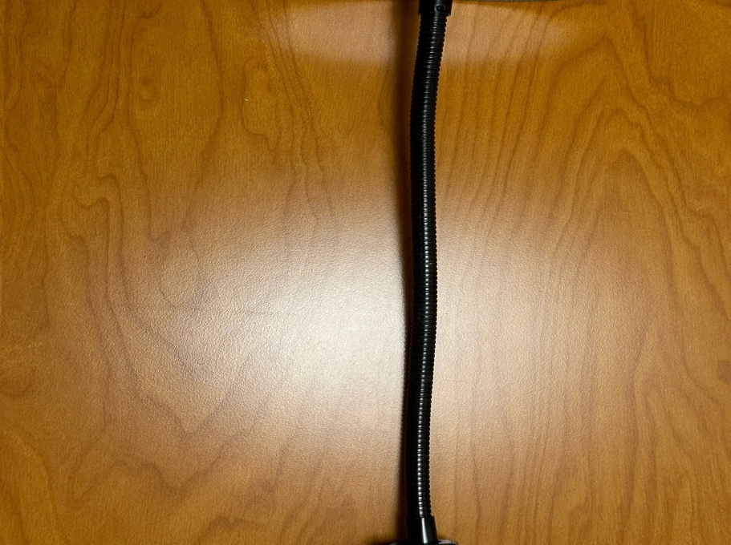

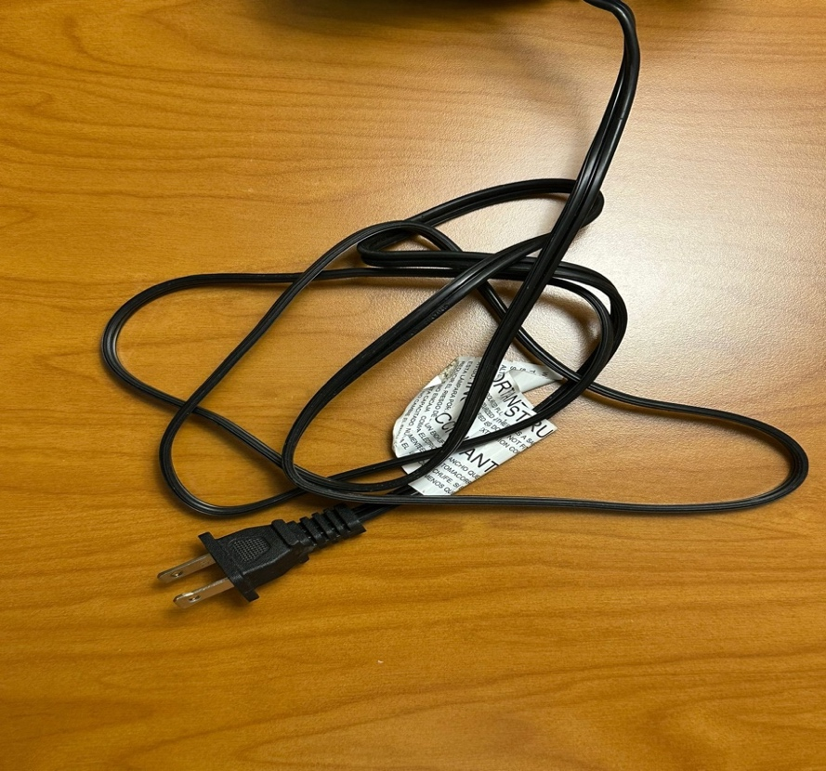
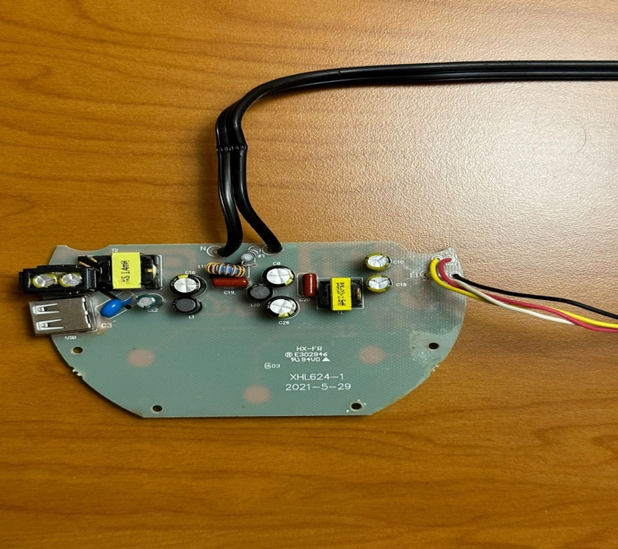
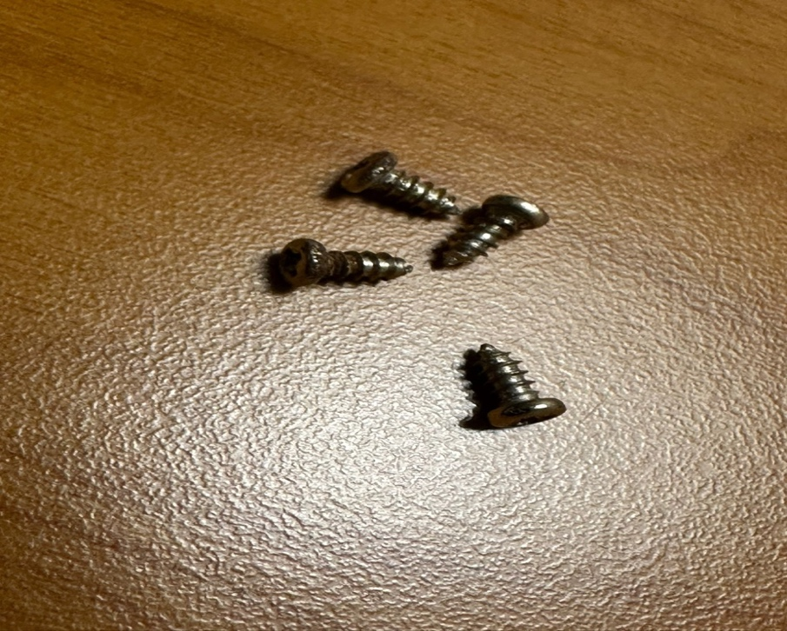
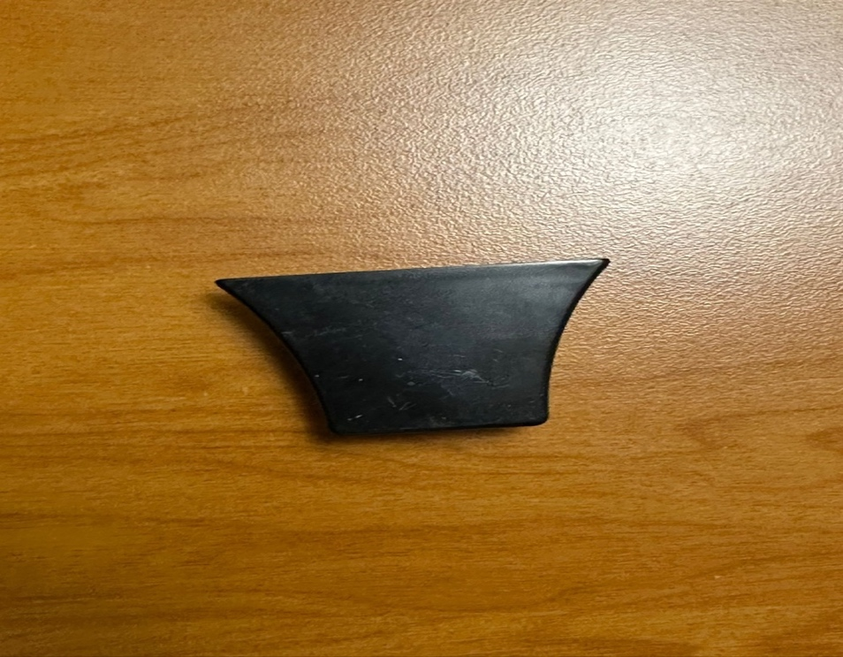
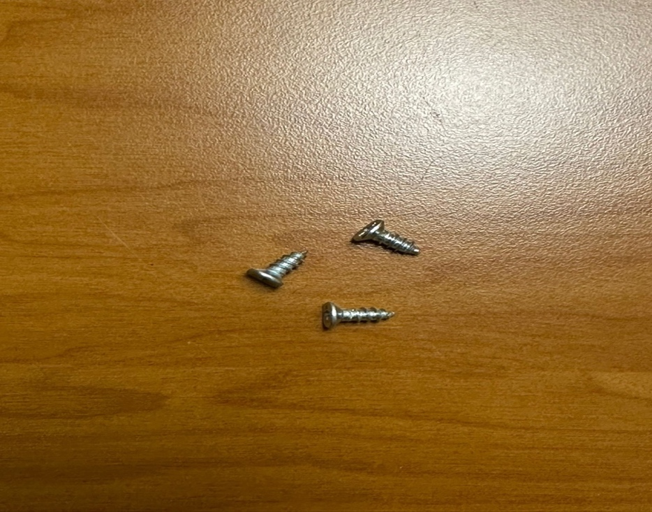
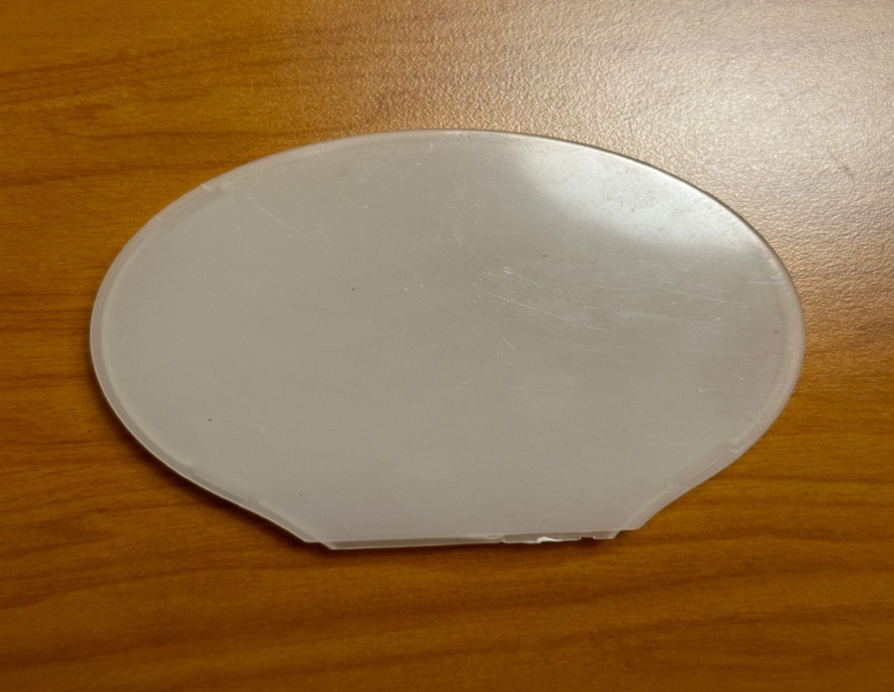
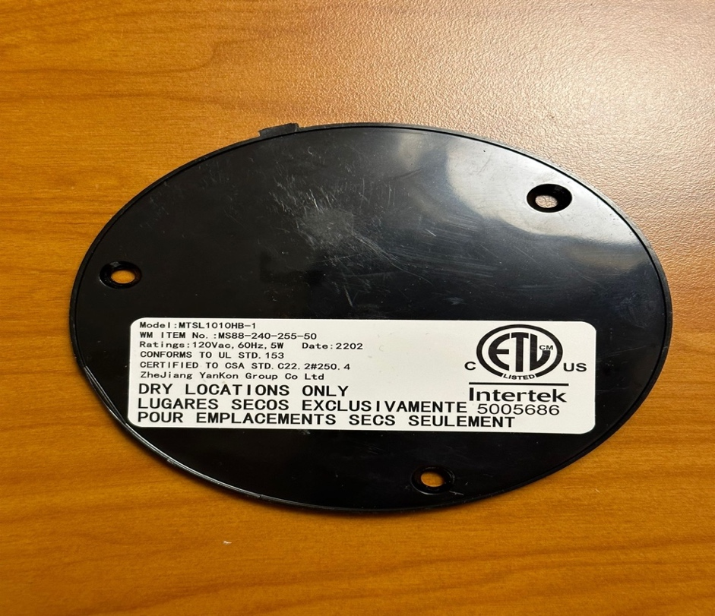
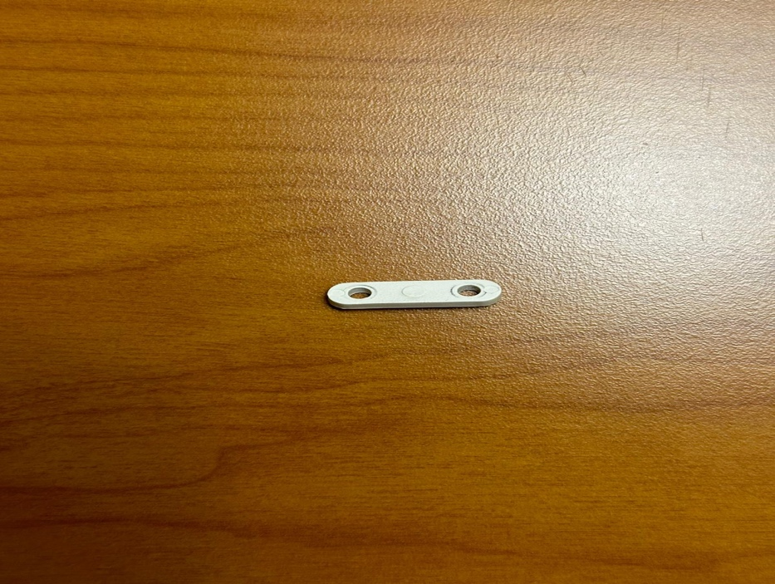
PRODUCT DISASSEMBLY
Base the LED lamp.
. LED Light Holder
Aluminum Rod Connecting
base and lamp head.
LED Light
Lamp Base (Top View)
LED Light holder base cover.
Screws
Electric Circuit Board
Power cord
Metal Weight
Screws
LED Light Cover
Wire Cover
Base cover

Slide 4
BILL OF MATERIALS
S.NO | PART NUMBER | PART NAME | PART QUANTITY | PART MATERIAL
1 | LED-001 | Lamp Base | 1 | Plastic
2 | LED-002 | LED Light Holder | 1 | Plastic
3 | LED-003 | LED Light | 1 | Electric Light source
4 | LED-004 | Aluminum Rod | 1 | Metal
5 | LED-005 | Power Cord | 1 | PVC, Copper
6 | LED-006 | Screws | 13 | Metal
7 | LED-007 | Wire Cover | 1 | Plastic
8 | LED-008 | Base Cover | 1 | Plastic
9 | LED-009 | Metal Weight | 1 | Metal
10 | LED-010 | Electric Circuit Board | 1 | Electric Laminate Board
11 | LED-011 | Light holder Base Cover | 1 | Plastic
12 | LED-012 | Light Cover | 1 | Plastic

Slide 5

STRATEGIES FOR RE-DESIGN
Explored Opportunities:
Material Selection: Focus on using recycled and recyclable materials, such as recycled plastics or metals, to reduce environmental impact. This choice not only supports a circular economy but also appeals to environmentally conscious consumers.
Energy-Efficient Lighting: Implementing the latest LED technology is crucial. LEDs are far more energy-efficient than traditional bulbs, have a longer lifespan, and reduce the lamp's overall carbon footprint.
Modular Design: Designing the lamp with interchangeable parts extends its lifespan. This approach allows users to replace or upgrade individual components rather than the entire lamp, reducing waste.
Sustainable Packaging: Opting for minimal, recyclable, or biodegradable packaging to minimize waste and environmental impact during shipping and handling.
Solar Power Compatibility: Investigating the feasibility of integrating a solar-powered option for the lamp to reduce reliance on grid electricity and appeal to off-grid users.

Slide 6

NON-VIABLE OPPORTUNITIES
Biodegradable Materials: While initially appealing, using fully biodegradable materials for structural components was not viable. These materials often lack the durability and heat resistance needed for a desk lamp, potentially compromising functionality and safety.
Hand-Cranked Power Option: Considered for its independence from electrical grids, this option was deemed impractical for a desk lamp. The effort required for the amount of light produced was not efficient or convenient for users.
Smart Connectivity Features: Adding advanced smart features (like app connectivity for remote control) was explored but not pursued. These features would significantly increase the cost and complexity of the lamp, and they don't align with the primary goal of sustainability.
Built-In Battery for Portability: While a built-in rechargeable battery would enhance portability, it would also increase the product's weight, cost, and environmental footprint due to the battery's life cycle and disposal issues.
Water-Based Power Source: Generating power through water-based technologies (like micro-hydro generators) was considered but found impractical for a desk lamp's scale and typical usage scenarios.

Slide 7
IMPROVEMENT IN MATERIALS AND PRODUCTION
Sustainable Materials: Shifting to recycled or recyclable materials such as recycled plastics, metals, or sustainable woods. These materials reduce the environmental impact associated with raw material extraction and processing.
Energy-Efficient Manufacturing: Implementing manufacturing processes that use renewable energy sources, like solar or wind power, can significantly reduce the carbon footprint of production.
Modular Design: Designing the lamp with replaceable parts. This approach not only extends the product's life but also simplifies repairs and upgrades, reducing the need for complete replacements and, hence, waste.
Local Sourcing and Production: Reducing transportation emissions by sourcing materials locally and manufacturing the product closer to the market. This approach also supports local economies.
Lean Manufacturing Principles: Adopting lean manufacturing techniques to minimize waste in the production process. This includes reducing excess material use, optimizing energy consumption, and implementing efficient logistics.
Non-Toxic Materials: Using materials free from harmful chemicals and toxins not only makes the lamp safer for consumers but also reduces environmental pollution during both production and disposal.
Low-Impact Packaging: Switching to minimal, recyclable, or biodegradable packaging materials. This reduces the environmental impact associated with packaging waste.
End-of-Life Disposal Planning: Designing the product with its end-of-life in mind, facilitating easy disassembly and recycling of components.

Slide 8
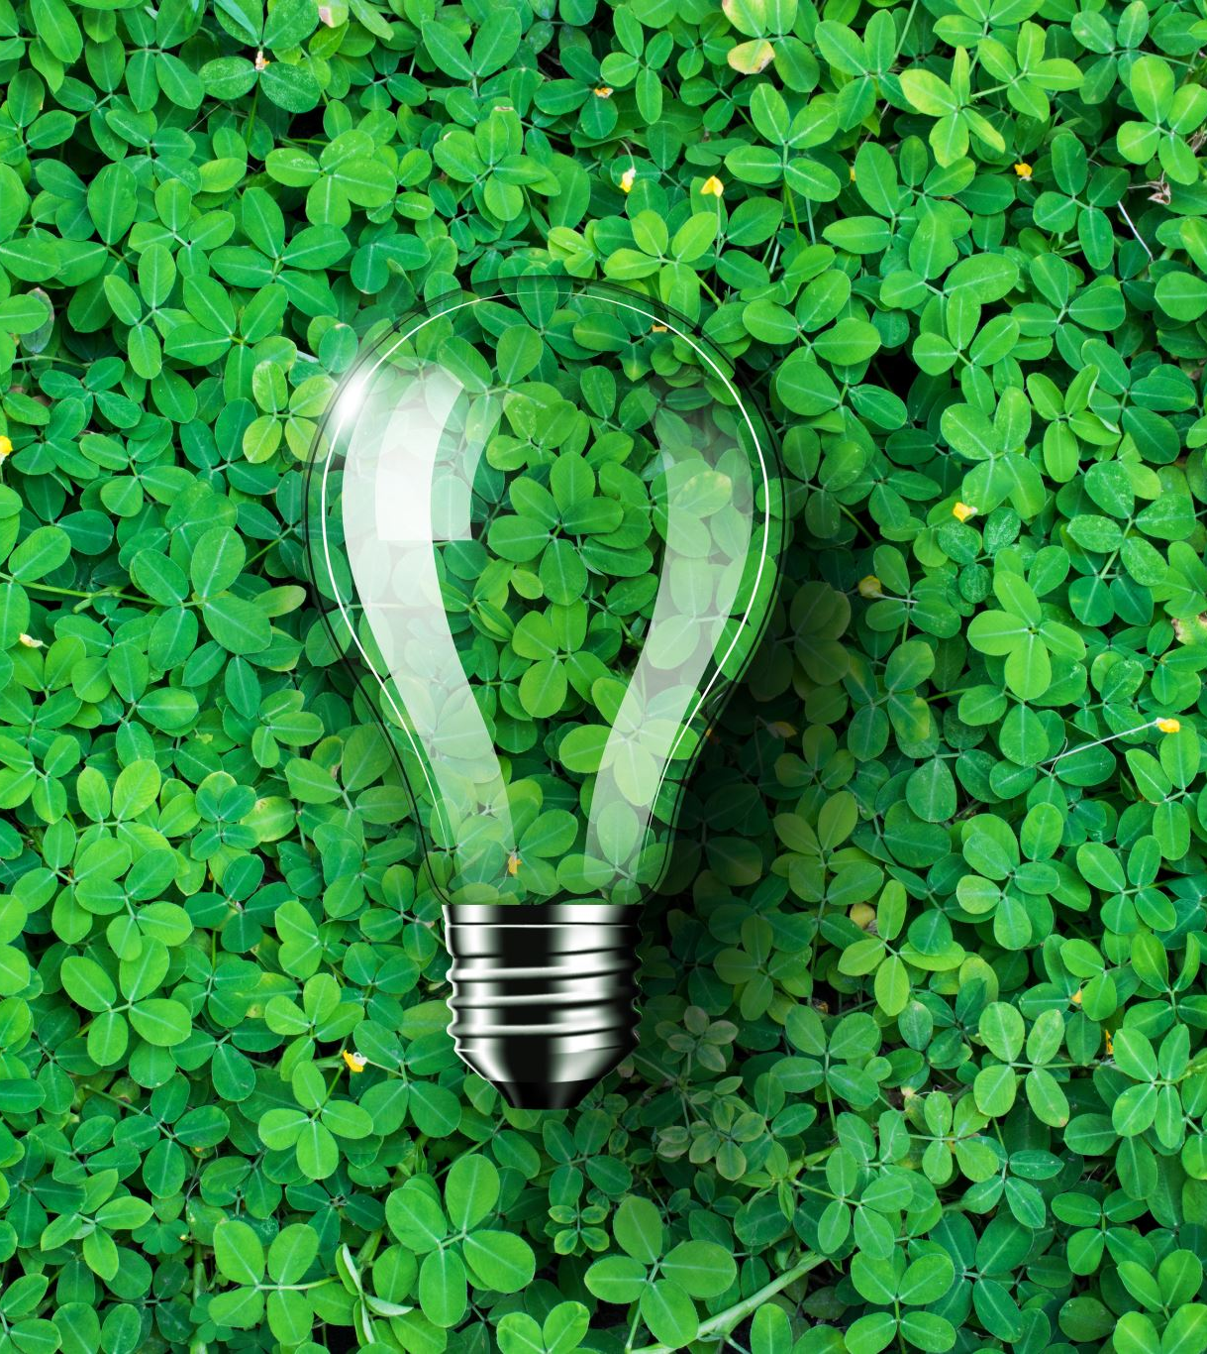
LIFE CYCLE ASSESSMENT
Life Cycle Assessment (LCA) is a crucial tool in quantifying the environmental impact of products like LED desk lamps. It provides a holistic view of a product's entire lifecycle, from its creation through its use and eventual disposal.
This comprehensive approach allows us to understand the environmental implications associated with various stages of a product's existence, helping us make informed decisions about sustainability and environmental responsibility.
In the case of LED desk lamps, LCA helps us compare their environmental performance with traditional lighting options like incandescent bulbs.
It considers factors such as the energy efficiency of LEDs, the materials used in their production, the reduction in greenhouse gas emissions due to lower energy consumption, and the potential for recycling or responsible disposal at the end of their lifespan.

Slide 9
SCENARIO OVERVIEW
Production and Materials: This phase involves the sourcing of raw materials, manufacturing processes, and assembly of the lamp. It includes the extraction of materials like plastics, metals, and electronic components, as well as the energy consumed during the manufacturing process. Sustainable practices in this phase focus on using recycled materials, reducing waste, and minimizing energy consumption.
Usage and Energy Efficiency: The operational phase of the LED desk lamp is characterized by its energy consumption over its lifespan. LED lamps are known for their low energy usage and long-lasting performance compared to traditional lighting. The scenario would consider the lamp’s energy source, the potential for solar power integration, and overall energy efficiency.
End-of-Life Management: At the end of its useful life, the lamp's disposal process is considered. This includes the potential for recycling its components, such as plastics and metals, and any hazardous waste management needed for electronic parts. Designing the lamp to be easily disassembled can facilitate recycling and reduce its environmental impact.

Slide 10
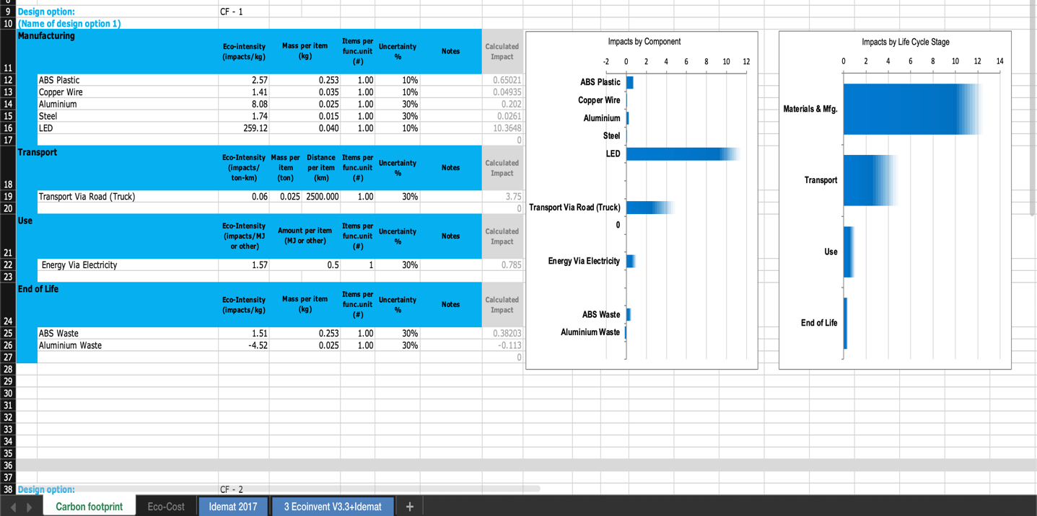
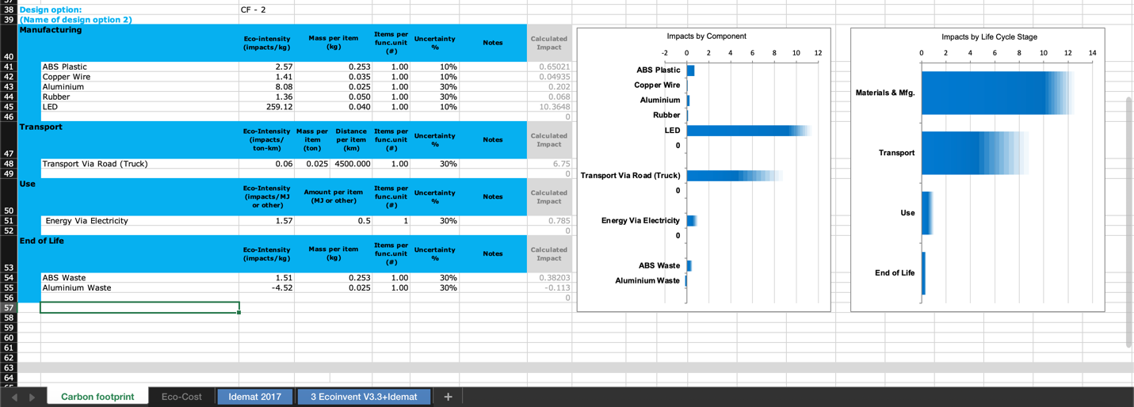
LCA CALCULATIONS
Carbon Footprints Calculations
Materials and Manufacturing Impact: In both design options, the materials and manufacturing stages have the largest carbon footprint, particularly the ABS plastic, copper wire, aluminum, steel, and the LED components. However, the impact of these materials is slightly reduced in the CF-2 design option.
Transportation: Transportation's impact is negligible in both design options, indicated by a value of zero. This suggests that the transportation of materials and the final product is not a significant contributor to the lamp's overall carbon footprint in these scenarios.
Usage: The energy used during the lamp's operational life (Usage) represents the second-largest impact on the carbon footprint for both design options, with a slightly lower impact in the CF-2 design.
End of Life: The end-of-life stage shows a negative impact in both designs, implying that recycling the materials (ABS waste and aluminum waste) provides a carbon credit or a reduction in the overall carbon footprint. CF-2 design offers a slightly better end-of-life impact compared to CF-1.

Slide 11
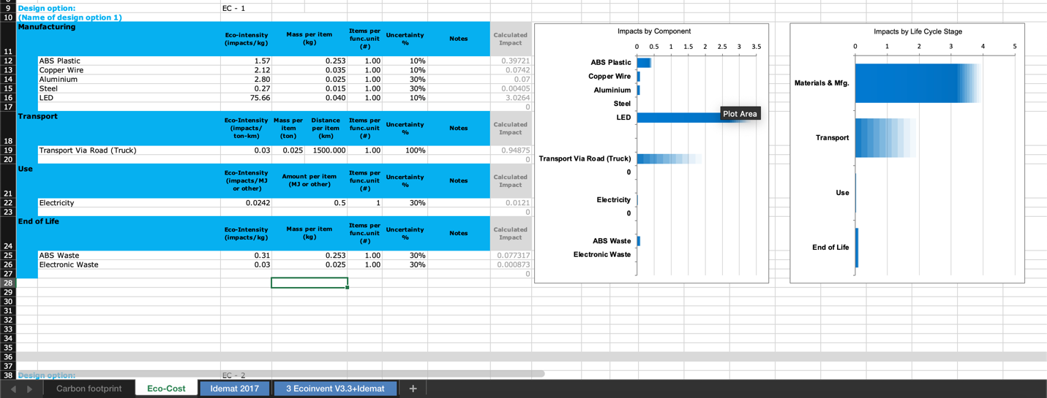
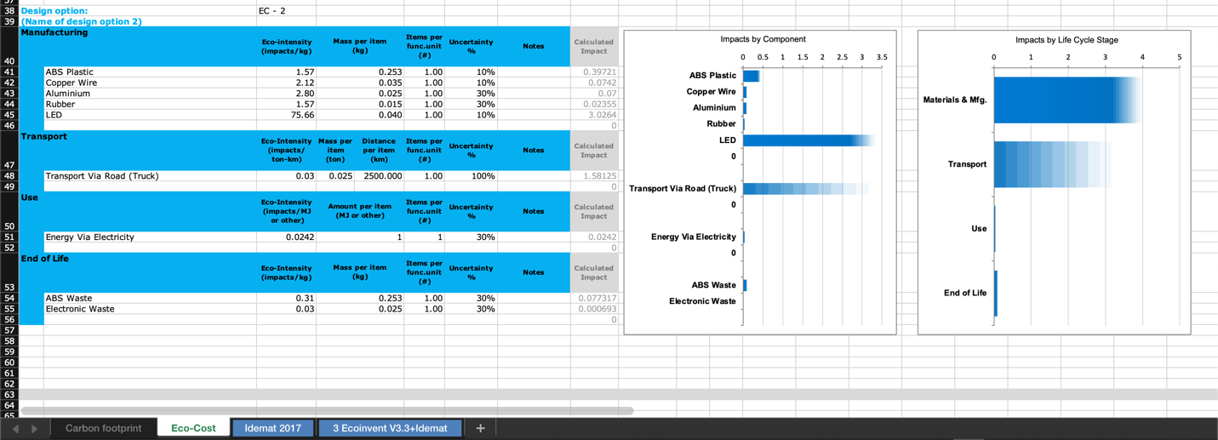
LCA CALCULATIONS
ECO COST Calculations
Materials and Manufacturing: Both design options show that the materials and manufacturing process are the largest contributors to the carbon footprint. In BC-1, ABS plastic, copper wire, and LED components have the highest impacts, whereas in BC-2, ABS plastic remains a significant contributor, but the impact of copper wire is reduced, and the addition of rubber is noted.
Transport Impact: In both BC-1 and BC-2, the impact of transportation via road (truck) is relatively small, indicating that transportation is a minor contributor to the lamp’s total carbon footprint.
Use Phase: The use phase, characterized by energy consumption through electricity, is a significant contributor to the lamp's carbon footprint in both BC-1 and BC-2, though it appears to be slightly lower in BC-2.
End of Life: The end-of-life impacts are shown to provide a small carbon credit in both design options, suggesting that the recycling of waste materials (ABS waste and electronic waste) offsets a part of the carbon footprint. BC-2 offers a slightly more favorable end-of-life impact.

Slide 12
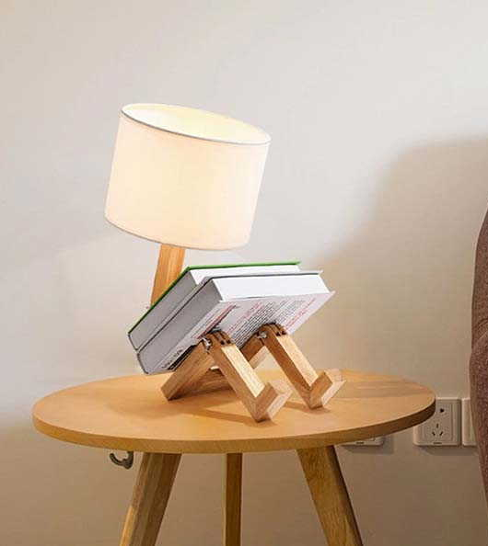
PROCESS LEARNINGS
Material Choice is Crucial: The selection of materials, particularly ABS plastic and copper wire, greatly influences the environmental impact of the lamp. Choosing materials with lower eco-intensity could significantly reduce the overall carbon footprint.
Manufacturing Process Optimization: The manufacturing process is a major contributor to the lamp's carbon footprint. Optimizing this process to be more energy-efficient, perhaps by using renewable energy sources, could result in a lower impact.
Use Phase Efficiency: The energy consumption during the use phase is significant. This underscores the importance of energy-efficient LED technology and possibly integrating additional energy-saving features or renewable energy compatibility.
End-of-Life Management Matters: The end-of-life phase offers an opportunity for carbon credit if the materials are recyclable. Designing for recyclability and ease of disassembly can help to offset the environmental impact of the lamp during its lifecycle.

Slide 13
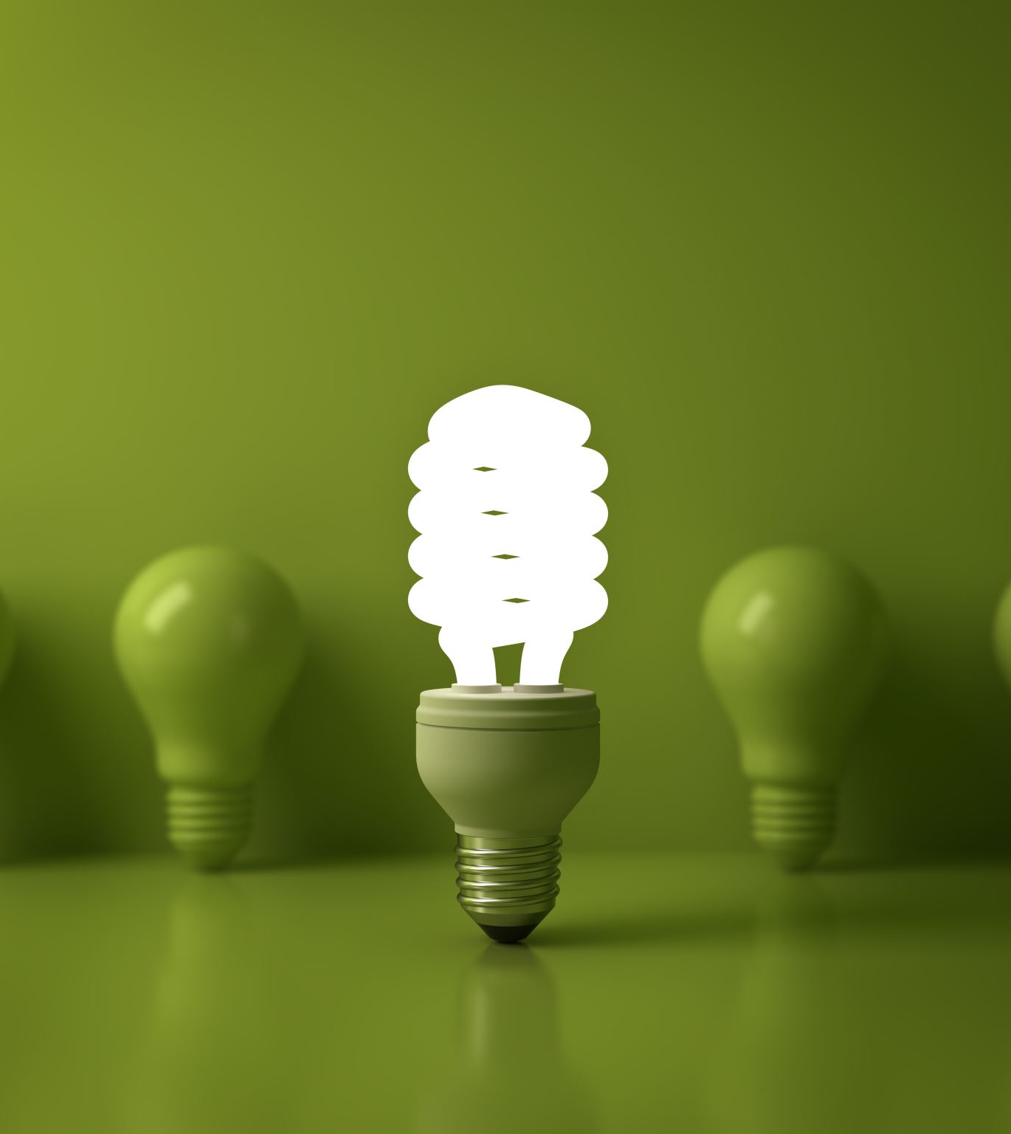
CONCLUSION
The comprehensive analysis of the LED desk lamp presents a product that successfully merges innovation with sustainability. Its energy-efficient design, combined with eco-friendly production and materials, aligns with current environmental trends and consumer preferences. While there may be higher initial costs associated with its sustainable features, the long-term economic, environmental, and social benefits justify the investment. The lamp not only meets the current market demand for green products but also sets a standard for future sustainable design in the industry. Overall, the LED desk lamp represents a forward-thinking approach to product development, balancing functionality, sustainability, and market viability.

Slide 14
WAYS TO MAKE LED LAMP MORE SUSTAINABLE
To make an LED desk lamp more sustainable, the main routes I would take include:
Material Innovation: Use materials with lower environmental impact, such as recycled plastics or bioplastics, and sustainable metals. The goal would be to ensure that all materials are either recyclable or biodegradable to minimize waste.
Energy Efficiency: Improve the energy efficiency of the LED itself and any electronic components. This could involve using the latest LED technologies that provide more light with less energy and incorporating features like dimmable settings or motion sensors to reduce energy consumption when not in use.
Production Process: Streamline the production process to reduce energy and material waste. This could include using renewable energy sources in manufacturing, optimizing logistics to cut down on transportation emissions, and implementing a closed-loop system where waste materials are reused.
Product Lifecycle Extension: Design the lamp to last longer through durable construction and modular design that allows for easy repair and parts replacement. This would extend the lifespan of the lamp, reduce the need for frequent replacements, and lower the product's overall environmental footprint.
End-of-Life Planning: Create a clear end-of-life strategy for the lamp, including take-back programs for recycling or refurbishing. This approach would ensure that the lamp's components are disposed of responsibly, reducing landfill waste and allowing materials to be recovered and reused.

Slide 15
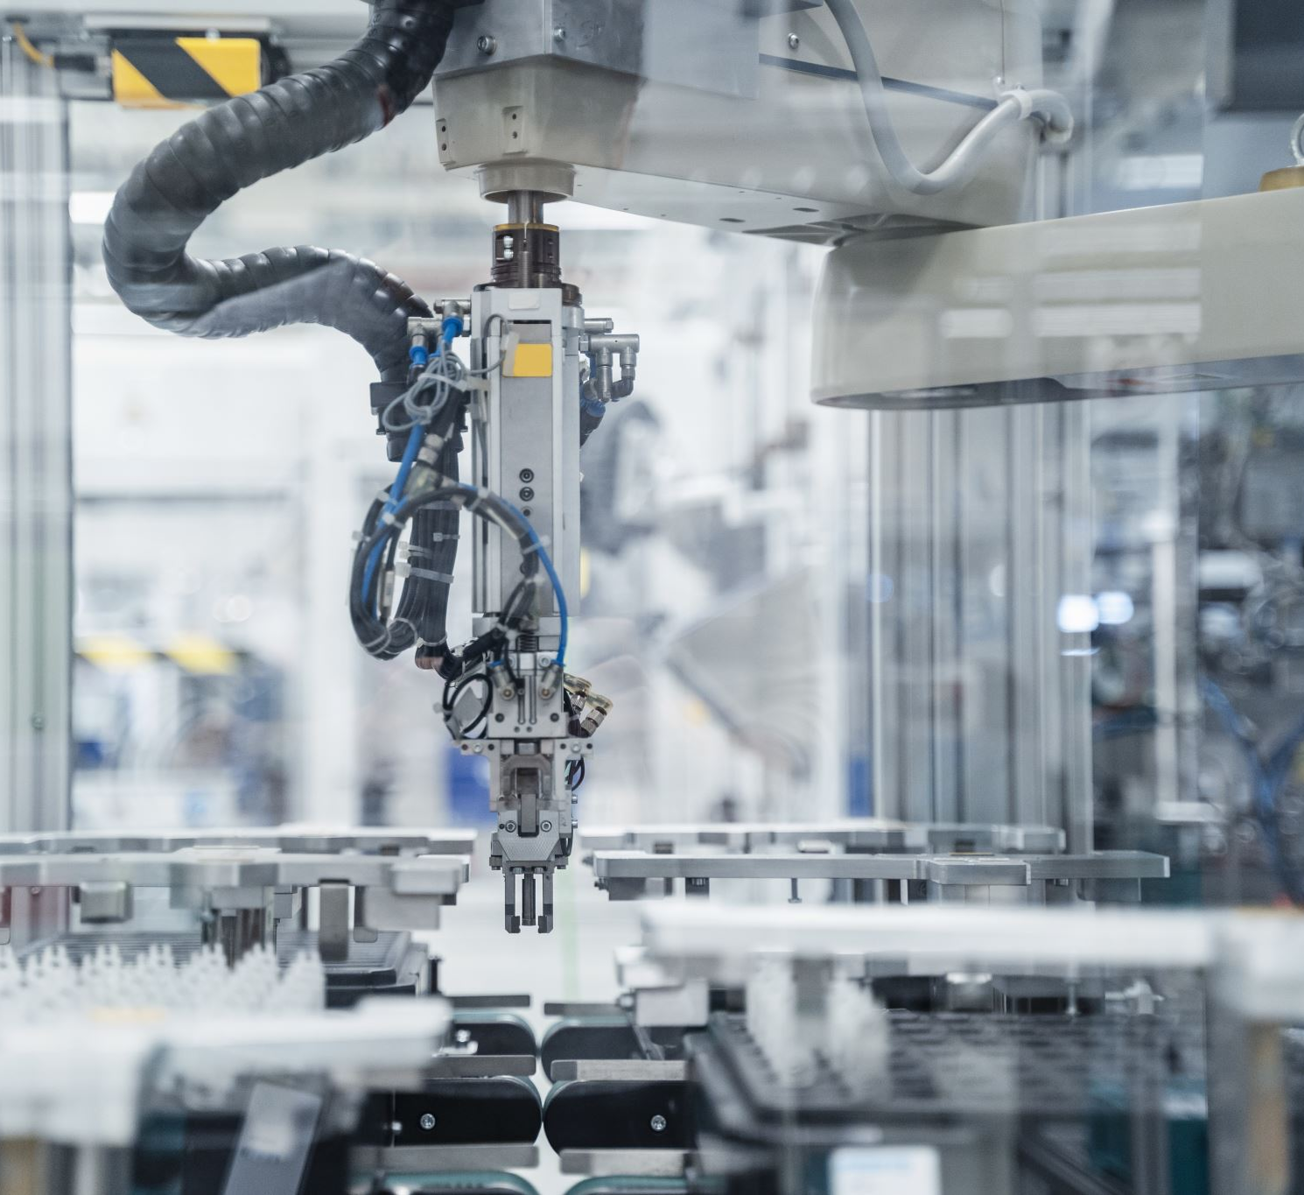
3D PRINTING
3D printing, also known as additive manufacturing, is a process that creates three-dimensional objects by layering materials, typically plastic or metal, based on digital models. Unlike traditional manufacturing, which often requires cutting away material, 3D printing builds objects layer by layer, which can minimize waste. This technology enables the production of complex and customized shapes with precision and efficiency. 3D printing is used across various industries, from prototyping and engineering to medical and consumer goods. Its versatility and ability to rapidly produce items make it a valuable tool for innovation and manufacturing.

Slide 16
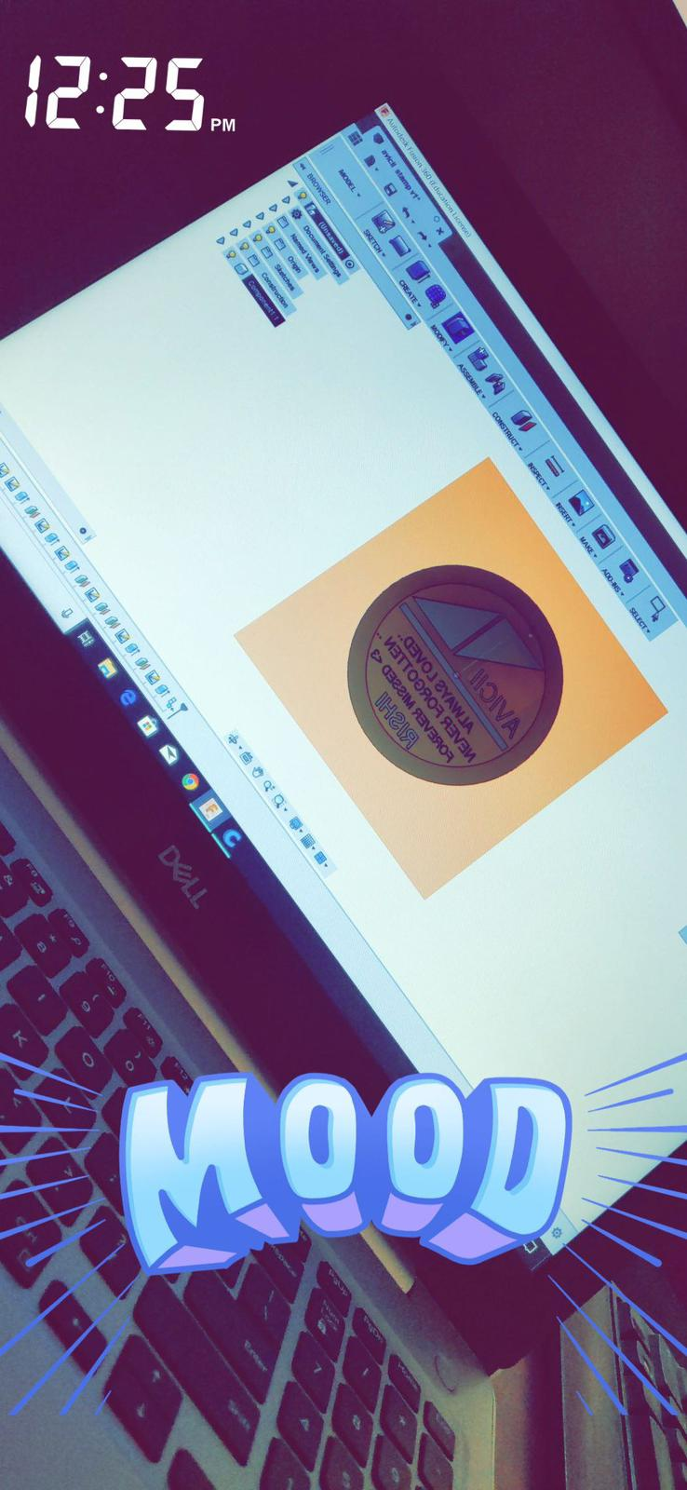
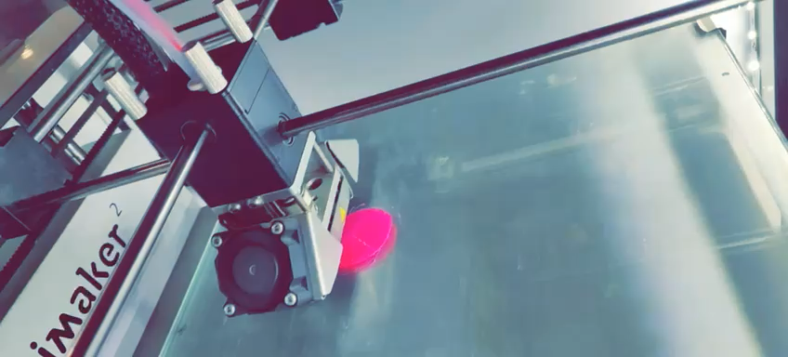

Slide 17
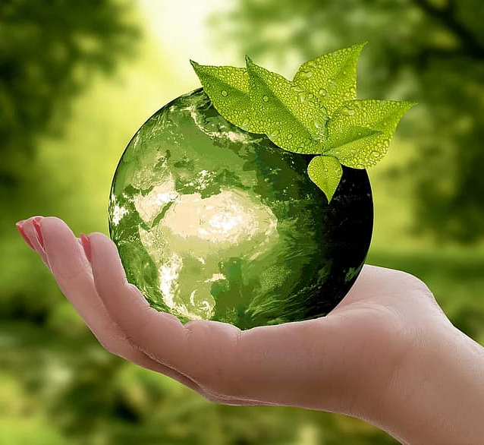
LEARNING OUTCOMES FROM THE CLASS
Understanding of Sustainable Practices: Gain a comprehensive understanding of sustainable practices within the manufacturing sector, including the use of renewable resources, reduction of emissions and waste, and the implementation of closed-loop systems for material and resource efficiency.
Life Cycle Assessment (LCA) Knowledge: Learn how to conduct LCAs to evaluate the environmental impacts associated with all the stages of a product's life from cradle to grave, which helps in making informed decisions to improve the overall sustainability of products.
Design for Environment (DfE) Principles: Acquire knowledge of DfE principles, which focus on the development of products with minimal environmental impact through their lifecycle. This includes considerations for material selection, energy efficiency, waste reduction, and end-of-life recyclability.
Policy and Regulatory Framework: Understand the policy and regulatory frameworks governing sustainable manufacturing. This includes knowledge of environmental regulations, industry standards, and certification processes that guide sustainable manufacturing practices.

Slide 18

REFERENCES
Peeters, J. R., Damen, K., Verbruggen, A. V., & Schoenberger, H. (2022). Circular Economy and Life Cycle Assessment: A Review. Resources, Conservation and Recycling, 179, 105976. https://doi.org/10.1016/j.resconrec.2022.105976
Phelan, P. E. (2019). A Sustainable Approach to Modern Manufacturing: A Need for Change. Procedia CIRP, 80, 21-26. doi:10.1016/j.procir.2018.12.158
Springwise. (n.d.). 3D Printed Table Lamp Uses Sustainable Materials. https://www.springwise.com/innovation/architecture-design/3D-printed-table-lamp-uses-sustainable-materials/
OECD. (n.d.). Action Steps for Sustainable Manufacturing.
https://www.oecd.org/innovation/green/toolkit/actionstepsforsustainablemanufacturing.htm
Veer, S., Verma, N., & Tiwari, S. (2017). An Investigation on Sustainable Manufacturing Practices in Indian MSMEs. Procedia CIRP,63,628633.doi:10.1016/j.procir.2017.03.310

Slide 19

THANK YOU! ☺ ANY QUESTIONS?

